Slide 1
Principles of Training
Overload (FIT), Progression, and Specificity

Slide 2
3 Basic Training Principles to follow when creating a workout program
1. Principle of Overload
    FIT (Frequency, Intensity, Time, Type)
2. Principle of Progression
3. Principle of Specificity

Slide 3
1. Principle of Overload
In order for the body to become stronger and function more efficiently, increased demands (overload) must be placed on it.
The principle of overload may be accomplished by increasing one of three variables:
  FIT
      Frequency
      Intensity
      Time

Slide 4
F.I.T.T.
Frequency: How many days per week you exercise
      Minimum of 3 days per week
Intensity: The amount of effort you demand from your body while exercising.
            Example: How much weight you lift, or how fast you run.
Time: How long you work out for (minutes, hours)
      As time increases, intensity decreases
Type: What type of exercises you are performing
      Don’t always perform push up to increase chest strength. Switch it up!

Slide 5
2. Principle of Progression
As you work harder (overload), your body adapts. After your body gets used to the work load, you must progressively increase the demands on your body for improvement to occur.
Think of the Principle of Progression as a schedule for when to apply the overload principle.

Slide 6
3. Principle of Specificity
COMMON SENSE!
You must select the appropriate physical activity that will specifically train the part of the body or component of fitness that you wish to improve upon.
    Performing push ups doesn’t help improve your lower body flexibility. Stretching helps improve your lower body flexibility.

Slide 7
Safety
You must start small when overloading the body to avoid injury.
    Don’t run 6 miles on you first day of cardiovascular training if your body isn’t used to it.
Progress only when your body has adapted to the demands.
    Don’t increase the amount of weight being lifted after one day of bench pressing.

Slide 8
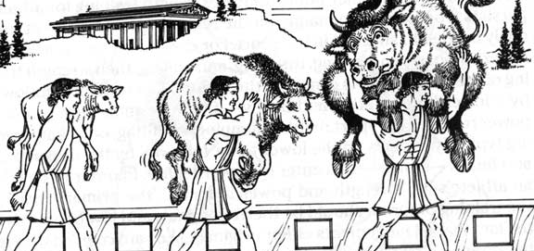
Legendary Milo of Crotona
Famous Greek Athlete who increased his strength by lifting a calf 4 times/week.
Why did this method of training work? What principles was he applying?

