Slide 1
Muscles and Their Movements

Slide 2
Muscles and Their Movements
Muscles move our bones which move our body.
Flexing: Creating less space at the joint
Extending: Creating more space at the joint

Slide 3
Muscles and Their Movements
Extending knee = Quadriceps
Flexing knee = Hamstrings

Slide 4
Muscles and Their Movements
Extending hip = Gluteus Maximus
Example: Rising from a squatted position

Slide 5
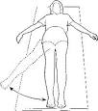
Muscles and Their Movements
Adding Legs Together = Adductors
Pulling Legs Apart = Abductors

Slide 6
Muscles and Their Movements
Pushing away from chest = Pecs
Pulling towards chest = Upper & Middle Back (Lats)

Slide 7
Muscles and Their Movements
Lifting arms = Shoulders
Shrugging Shoulders = Trapezius

Slide 8
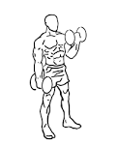
Muscles and Their Movements
Flexing elbow = Bicep
Extending elbow = Tricep

Slide 9
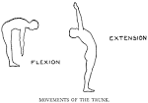
Muscles and Their Movements
Flexing Trunk = Abs
Extending Trunk= Lower Back

